Slide 1
Developing criteria for the application of Directive 98/58 to welfare of dairy cows
Peter Stevenson
Compassion in World Farming

Slide 2
New report for EP Petitions Committee on animal welfare by DG for Internal Policies. Author: Prof Donald Broom
The report states “dairy cow welfare ... may be considered to be the second greatest animal welfare problem in the EU”
It also states “Dairy cows producing large quantities of milk have high levels of leg disorders, mastitis and reproductive disorders. The proportion of cows affected by one or more of these disorders is high and the animals live with the poor welfare for a substantial part of their lives”.

Slide 3
Article 3 of Directive 98/58
Requires Member States:
“to make provision to ensure that the owners or keepers take all reasonable steps to ensure the welfare of animals under their care and
to ensure that those animals are not caused any unnecessary (i) pain, (ii) suffering or (iii) injury”
Article 3 is a demanding provision - it requires owners & keepers to take “all” reasonable steps.
Owners & keepers must “ensure” dairy cows’ welfare and “ensure” that they are not caused any unnecessary pain, suffering or injury.
Commission says EFSA Scientific Report & Opinions can help us understand what should be taken into account when assessing each of these factors

Slide 4
Main factors to be looked at when assessing compliance with 98/58
Lameness
Cubicle design
Injuries & sores
Bedding
ANIMAL- BASED
RESOURCE- BASED
Body condition
Nutrition
Mastitis
Floor condition
Dirty animals
Dirty housing

Slide 5
CowSignals: Economic benefits of good dairy cow welfare
CowSignals Answer to ‘what can I earn by improving welfare?
“more fun, more milk, more money, less trouble”
Good beds: 1 hour more resting per day gives one extra litre of milk
Average resting time is estimated around 10 hours in cubicles
Best farms 14 hours!
This gives 4 extra litres milk per cow per day
Every disease cost around 250 Euro! (mastitis, endometritis, ketosis, lameness, milk fever)

Slide 6
Better health & welfare can improve longevity. This spreads the cost of raising a heifer until the age at which she can be milked over a larger lifetime milk yield
If due to poor health and welfare, a cow has just 2-3 lactations, the cost of rearing her till she can produce milk is 6 cents per litre
But with cows producing 5 healthy lactations that cost drops to just 3 cents per litre – so this gives an extra 3 cents per litre profit

Slide 7
DeLaval: Economic benefits of improving health & reducing mortality
Keeping cows in the herd for an additional healthy lactation | Increase in profitability of €110 per cow per year (US study)
Culling and deaths in early lactation | Cost up to €740 per case
Moving a herd from 10% lowest to the best 10% in regard to cow mortality | Savings of as much as €670 per cow per year (Danish study)

Slide 8
Lameness
EFSA: foot & leg disorders are the major welfare problem for dairy cows – and most lame cows are in pain
EFSA: most estimates of lameness are within the range 20 to 25%
EFSA: no reduction in prevalence of lameness in last 20 years
EFSA: “When the prevalence of recognisable locomotor difficulties in dairy cattle is above 10%, this indicates that the prevention programme is inadequate”

Slide 9
Economic benefits of preventing lameness
Lame cows produce less milk & it is more difficult to get them in calf
They need additional attention & work on an ongoing basis
Veterinary & medication costs

Slide 10
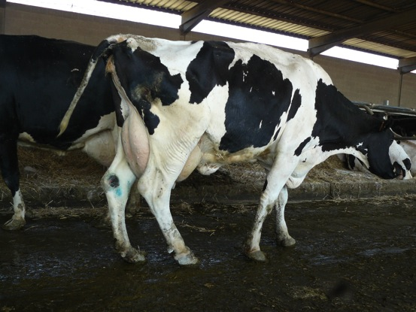
Factors to consider when assessing compliance with 98/58 regarding lameness
Incidence of lameness?
Does the competent authority suggest a maximum level of lameness so that inspectors & farmers have a clear target?
Is lameness being scored? Ideally this should be done monthly for early identification of subclinical lameness

Slide 11
What steps are farmers taking to prevent & treat lameness?
Under 98/58 farmers must take “all reasonable steps” to “ensure” a low level of lameness
Have farmers got a foot health plan?
Do farmers provide foot baths & hoof trimming?
Have cows got a deep bed of straw or sand? - too much standing causes damaged hocks & hoof problems, leading to lameness
If cubicles are too small or badly designed or the barn is overcrowded, cows will stand more – leading to lameness
Are farmers achieving early detection and providing prompt, effective treatment of lame cows?

Slide 12
Good Floor Condition: vital to reduce lameness & injuries
Floors should be neither rough (can lead to foot injuries) nor too smooth; they must be non-slip

Slide 13
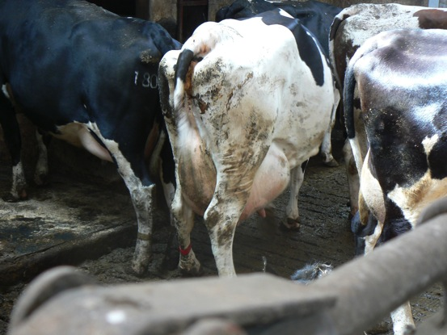
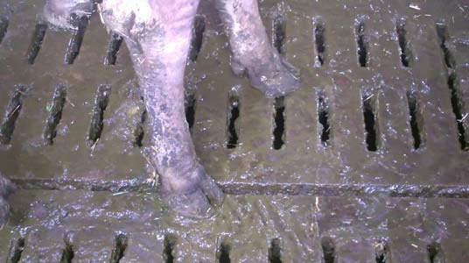
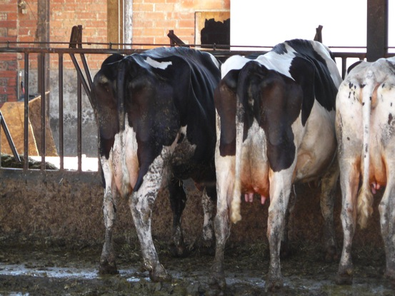
Cows, housing, feeding areas & floors must be kept clean & dry to reduce infection pressure

Slide 14
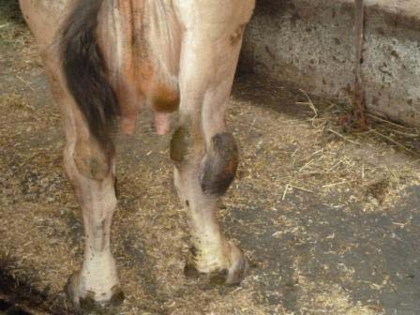
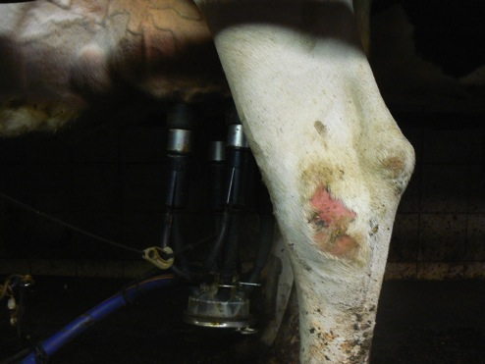
Sores, wounds & injuries must be minimised
Avoid sharp edges & protrusions. Repair damaged fittings

Slide 15
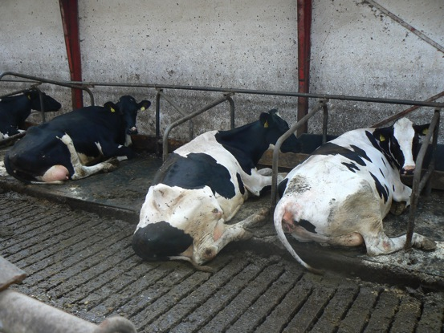
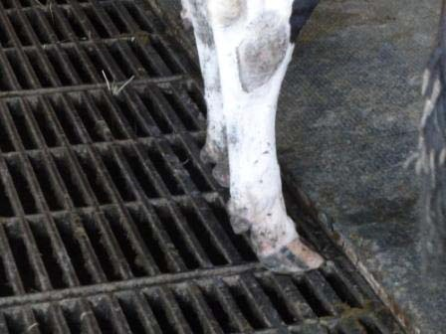
Cubicles: length & width
Must be long enough to prevent cows lying or standing with their back legs in the passageway
Must be wide enough to prevent cows colliding with the cubicle fittings while lying down or standing up

Slide 16
Body condition scoring
Valuable for welfare, reproduction, health & longevity
Too thin cows are at risk of disease, infection & fertility issues
Too fat cows are at risk of difficult calvings, fatty liver & displaced abomasum

Slide 17
Mastitis
EFSA states mastitis remains a major challenge & estimates that the incidence of clinical mastitis varies between 20-35% cows per herd per year

Slide 18
Economic benefits of preventing mastitis
High somatic cell counts can incur financial penalties imposed by the processor
Increased staff time dealing with mastitis cases
Costs of veterinary care & medicines
Milk thrown away due to contamination by medication
Reduction in yields due to illness & any permanent damage to udder tissue
Cost of reduced longevity due to premature culling

Slide 19
Preventing mastitis
EFSA states prevalence of mastitis should be reduced through:
Identification & elimination of carrier cows
prevention of transmission of infection from cow to cow or through the environment
improvement of the immune system by minimising stress factors & a nutritionally-balanced feed intake
Hygienic teat management and regular testing & maintenance of milking machines are important
Provision of a clean, dry environment for standing (e.g. feeding area & alleyways) & lying are important in controlling mastitis
Keep cows clean
Good ventilation
Are farmers achieving early detection of mastitis and providing prompt, effective treatment?

Slide 20
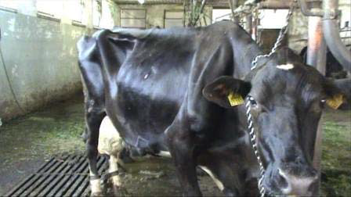
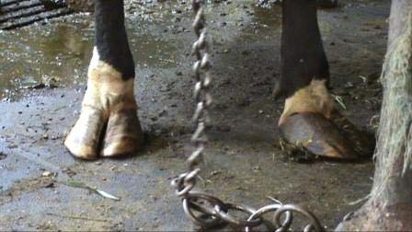
Tie stalls: tethering of dairy cows
In some Member States many cows are tethered indoors for most or all of year – sometimes tethered like this 24 hours a day all year round
Unable to move other than to lie down & stand up and take a few steps backwards, forwards & sideways

Slide 21
Is use of tethering-stalls compatible with 98/58?
Hard to believe that farmers using tethering-stalls are taking “all reasonable steps” to:
“ensure” the cows’ welfare
“ensure” they are “not caused any unnecessary pain, suffering or injury”
One third of the Bavarian cows are still being tied all year round https://www.agrarheute.com/tier/rind/bbv-fordert-mehr-zeit-fuer-ausstieg-anbindehaltung-530453
Bavaria is providing Rural Development funding to support farmers in moving from tether-stall systems
In Germany my understanding is that Real & Lidl do not accept milk from tethered cows

Slide 22
DairyCo economic data
Milk yield is not the main driver of profit. It is production costs that are the
key determinant of profit - and feed costs (the main component of overall costs) are lower in grass-based systems
 | Cows at grass | High-output cows
Feed efficiency* (kg dry matter per litre - excluding grazed grass) | 0,63 | 0,76
Yield (litres per cow per year) | 5602 | 8593
Revenue index (pence per litre)(Cows at grass = 100) | 100 | 91
Net margin index (pence per litre) (Cows at grass = 100) | 100 [2013 figure: 100] | 52 [2013 figure: 50]
DairyCo’s 2012 Milkbench+ study

Slide 23
Stress-free stockmanship
Should be stress-free for handlers & the cows
Quiet, calm
Move slowly
Learn how to use cows’ flight zone
Don’t stand directly behind cow
No shouting, no sticks
© CowSignals

